Slide 1
Airbnb Price Prediction
Big Data Project
A.Y. 2022-2023
Faculty of Ingegneria dell'informazione, informatica e statistica
Department of Informatica
Alessio Lucciola
Matr. 1823638

Slide 2

Introduction
Airbnb is a platform used to rent accommodations. There are two actors:
Hosts: They own an accommodation and can publish a new listing to the website;
Guests: They can search for a specific listing and rent it for a certain amount of time.
The price ($/per night) of an accommodation depends on many aspects and choosing the right one could help to increase its success and so the incomes. The goal of this project is to build a price predictor to help the hosts make this decision.

Slide 3
Data
The dataset containing the Airbnb information of different cities is freely available on the Airbnb website¹;
An aggregation of datasets of different European cities² allowed me to create a single dataset of ~320k observations;
Each observation has 68 features describing an accommodation (e.g. number of bedrooms, bathrooms, room types, host information, location, scores, price, etc..). The target variable is the price that is a continuous value so it is a regression task.
¹Source: http://insideairbnb.com/get-the-data/ ²List of cities: London, Paris, Rome, Madrid, Milan, Barcelona, Lisbon, Vienna, Berlin, Athens, Lyon, Dublin, Amsterdam, Brussels, Munich

Slide 4
Project Pipeline
Data cleaning: The dataset contains lots of features with different formats (strings, lists, floats). The goal is to remove the useless data and put everything in a ML friendly format;
Feature engineering: To extract further information from location features;
Feature selection: To select the most informative features to train a model;
Model creation: To train the model and evaluate it;
Real scenario tests: Using a web application built with ReactJS.

Slide 5

Project Pipeline
Data cleaning: The dataset contains lots of features with different formats (strings, lists, floats). The goal is to remove the useless data and put everything in a ML friendly format;
Feature engineering: To extract further information from location features;
Feature selection: To select the most informative features to train a model;
Model creation: To train the model and evaluate it;
Real scenario tests: Using a web application built with ReactJS.
Project carried out with Apache Spark (but during feature selection I converted the Spark dataframe to a Pandas one to make some plots).

Slide 6
Data Cleaning 1
Each of the 68 features was cleaned separately. In summary:
Non-informative features (e.g. id, url, scraping dates, etc..) removed;

Slide 7
Data Cleaning 1
Each of the 68 features was cleaned separately. In summary:
Non-informative features (e.g. id, url, scraping dates, etc..) removed;
Null values processed in different ways:
Rows with no host information (only 50 rows) removed;
About 60k rows with no scores imputed with the average;
About 20k rows with missing bedrooms filled with the predictions of a simple Logistic Regression model that uses the number of beds and accommodates (accuracy ~76%);
Some N/A values were left untouched (e.g. “host response time” null values filled with “unknown”).

Slide 8
Data Cleaning 1
Each of the 68 features was cleaned separately. In summary:
Non-informative features (e.g. id, url, scraping dates, etc..) removed;
Null values processed in different ways:
Rows with no host information (only 50 rows) removed;
About 60k rows with no scores imputed with the average;
About 20k rows with missing bedrooms filled with the predictions of a simple Logistic Regression model that uses the number of beds and accommodates (accuracy ~76%);
Some N/A values were left untouched (e.g. “host response time” null values filled with “unknown”).
String (categorical) values turned into numerical ones with a String indexer:
E.g. Cities were represented by strings, I turned them into integers (Barcelona → 1, Rome → 2, etc..);

Slide 9
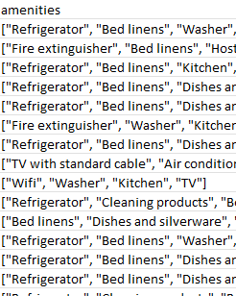
Data Cleaning 2
Amenities: Represented by a list of strings. They were not unique so I had to categorize them first and add them as different features.
Initial list of amenities

Slide 10
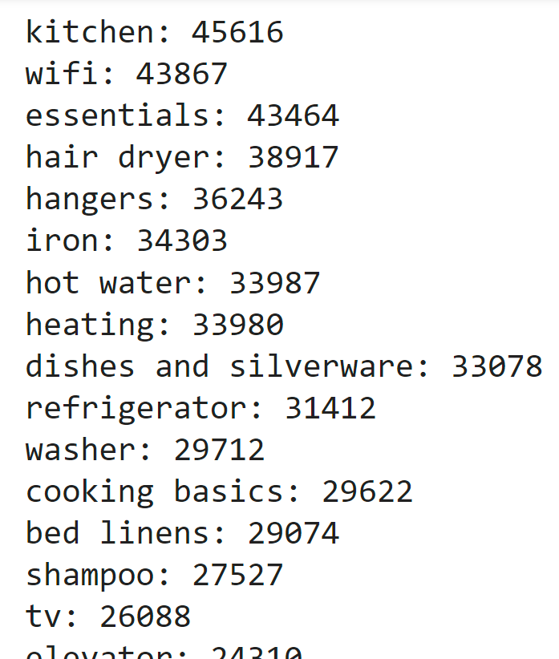
Data Cleaning 2
Amenities: Represented by a list of strings. They were not unique so I had to categorize them first and add them as different features.
Initial list of amenities
Counted the most common amenities

Slide 11
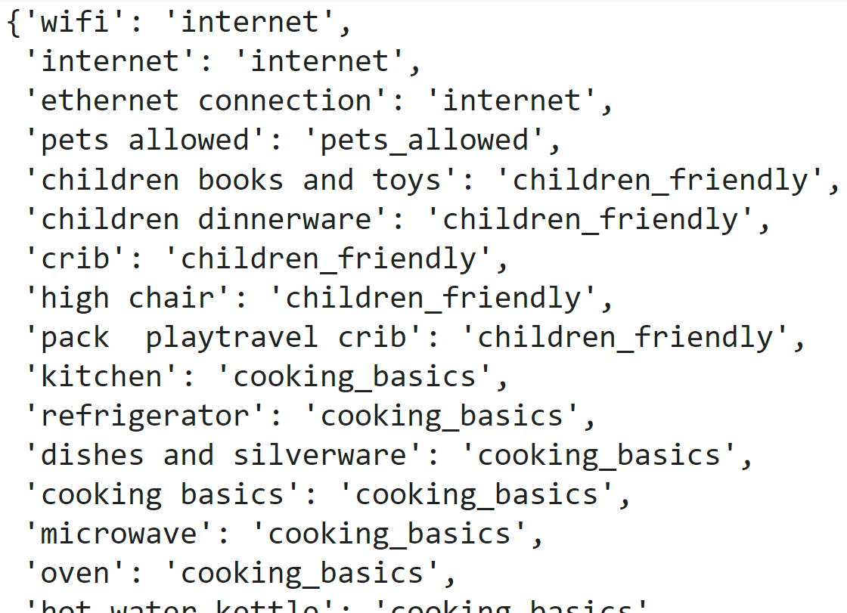
Data Cleaning 2
Amenities: Represented by a list of strings. They were not unique so I had to categorize them first and add them as different features.
Initial list of amenities
Counted the most common amenities
Categorization of the amenities

Slide 12
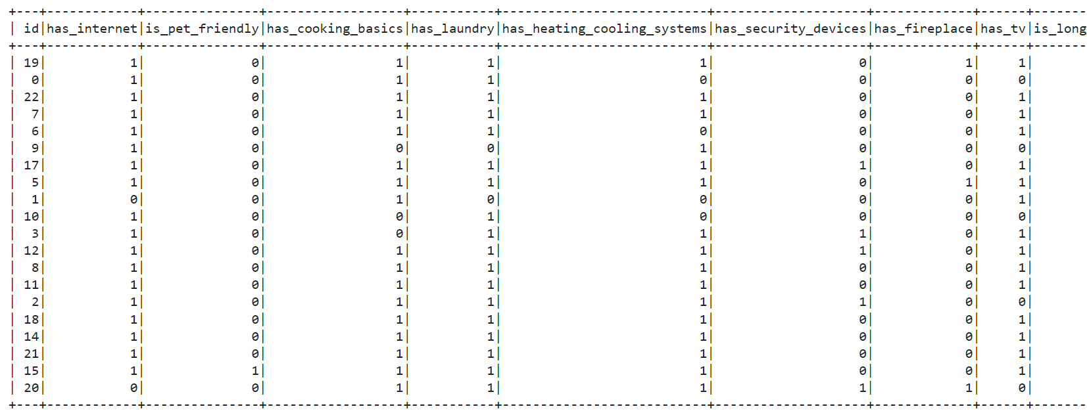
Data Cleaning 2
Amenities: Represented by a list of strings. They were not unique so I had to categorize them first and add them as different features.
Initial list of amenities
Added 22 new columns (one for category) and filled them with booleans: 1 if the amenity is in the accommodation, 0 otherwise

Slide 13
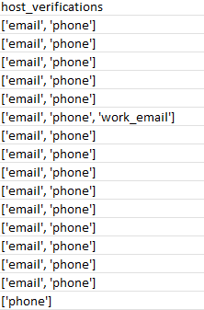
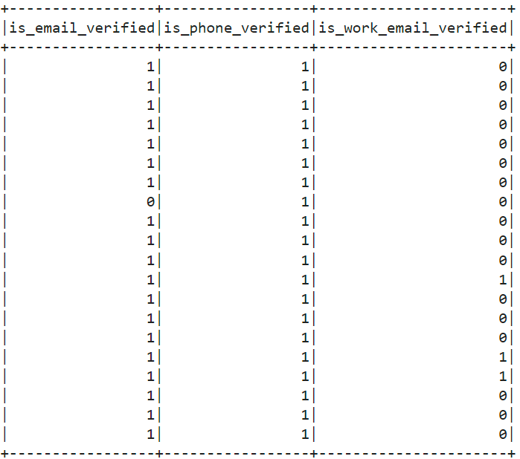
Data Cleaning 3
Host verifications: Same as the amenities.
Initial host_verifications list
Added 3 new columns (one for verification method) and filled them with booleans: 1 if host is verified with that method, 0 otherwise

Slide 14
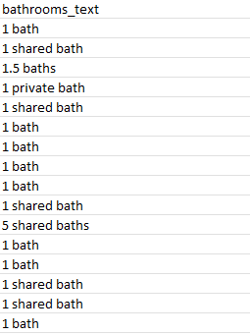
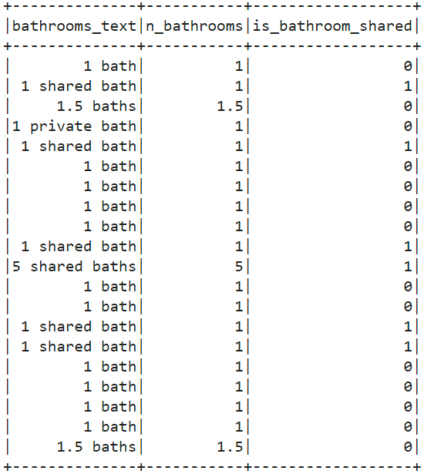
Data Cleaning 4
Bathrooms: Represented by a string with number of bathrooms and optionally, the information if they were shared or private.
Initial bathroom_text column
New column with the extracted information

Slide 15
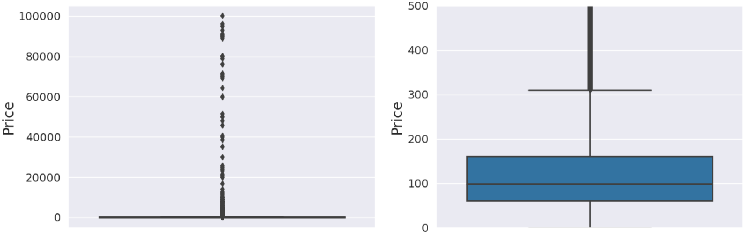
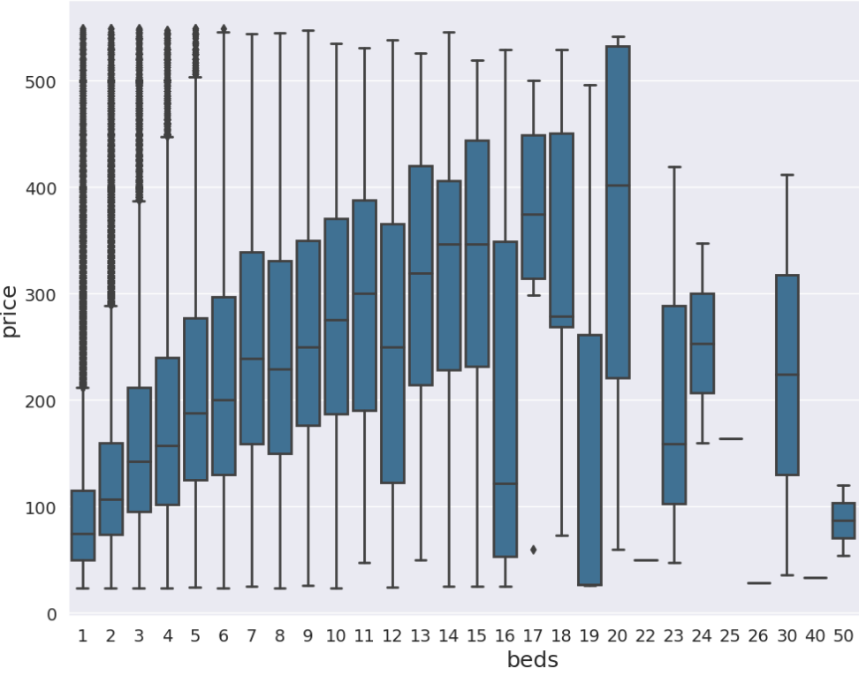
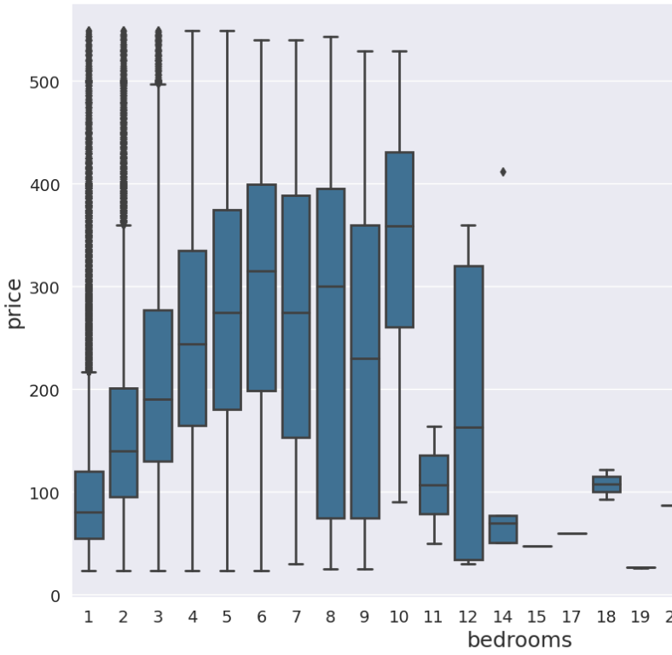
Data Cleaning 5
Outliers removal: Some features had data points that were significantly different from the rest of the dataset.
Price: Values from 0$ to $100k. I applied Winsoring and removed the 0.03% of the highest and lowest prices.
Size of the accommodation: Using a harder approach (helped by some graphs), I also removed very large accommodations to enhance the correlation between size of the Airbnb and price.
Outliers in the price feature
Outliers in the characteristics of the accommodation features

Slide 16
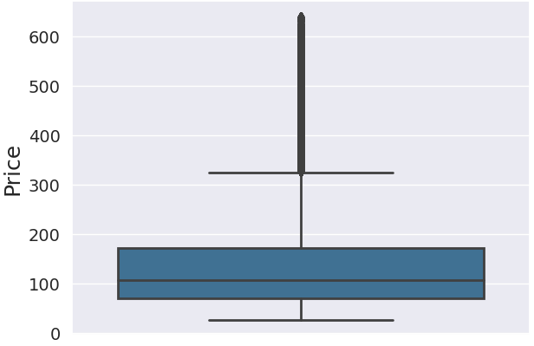
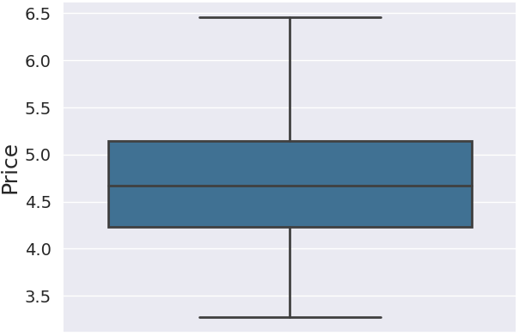
Data Cleaning 6
Scaling features: Applied log(*) to some features (e.g. price) in order to reduce the dynamic range of the feature preserving the differences while the scale was not dramatically skewed. In advance, I needed a simple way to go back to the original value when the prediction was done. This way distances are preserved, values are easily comparable and convergence is faster.
Original “price”
Log(price)

Slide 17
Feature Engineering 1
Since I considered different cities around Europe, I needed to find a “universal way” to represent the relationship between the price and the location. I had latitude and longitude of each Airbnb so I used them to compute some distances:
Between the accommodation and the nearest station (metro, train);
Between the accommodation and the city center;
Between the accommodation and the nearest point of interest (e.g. for Rome I selected the Colosseum, Trevi Fountain and St.Peter’s Basilica).
The hypothesis was that the value of an accommodation usually increases if those distances are minimized ³.
³Sources: https://www.sciencedirect.com/science/article/pii/S2666957922000040 https://www.openagent.com.au/blog/how-much-extra-value-does-proximity-to-a-train-station-add-to-a-property

Slide 18

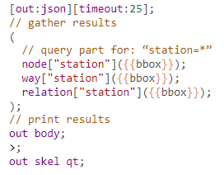
Feature Engineering 2
This operation was accomplished using Open Street Map to get the positions of each station/poi/city center across different cities and use them to compute the distances:
OSM query to extract stations

Slide 19
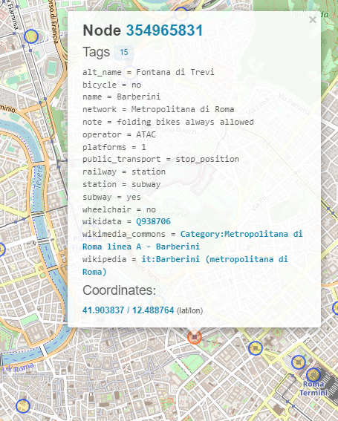
Feature Engineering 2
This operation was accomplished using Open Street Map to get the positions of each station/poi/city center across different cities and use them to compute the distances:
OSM query to extract stations
Result in OSM

Slide 20
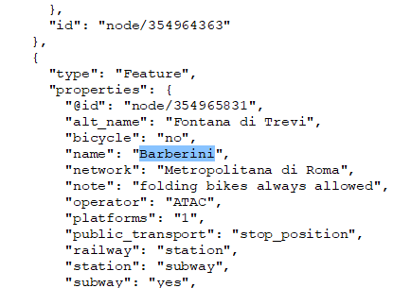
Feature Engineering 2
This operation was accomplished using Open Street Map to get the positions of each station/poi/city center across different cities and use them to compute the distances:
OSM query to extract stations
Result in OSM
JSON with the extracted stations

Slide 21
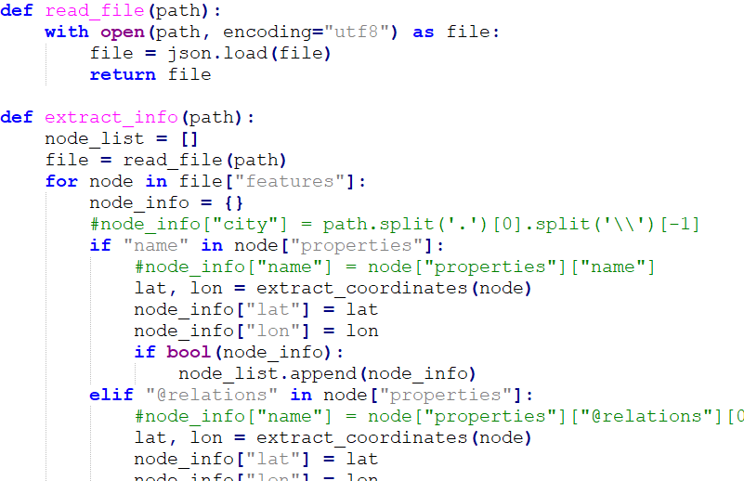
Feature Engineering 2
This operation was accomplished using Open Street Map to get the positions of each station/poi/city center across different cities and use them to compute the distances:
Python script to extract useful information from OSM scraped data

Slide 22
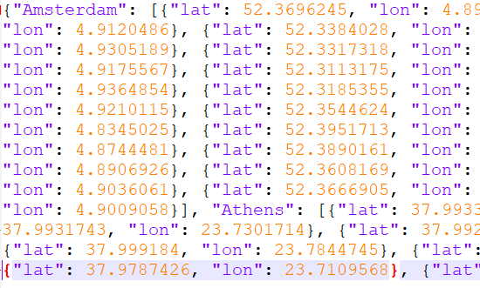
Feature Engineering 2
This operation was accomplished using Open Street Map to get the positions of each station/poi/city center across different cities and use them to compute the distances:
Python script to extract useful information from OSM scraped data
JSON with useful station coordinates

Slide 23
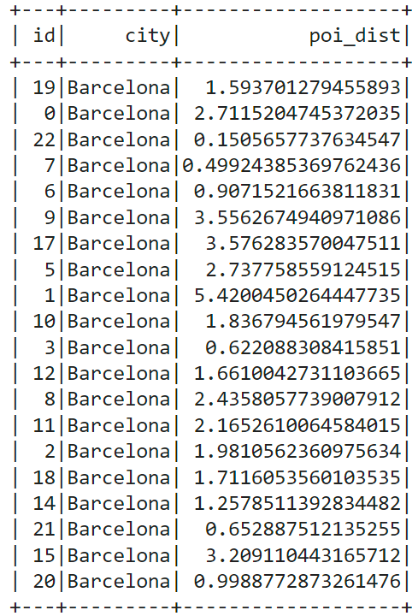
Feature Engineering 2
This operation was accomplished using Open Street Map to get the positions of each station/poi/city center across different cities and use them to compute the distances:
Python script to extract useful information from OSM scraped data
Compute minimum distance between each accommodation and a (train/metro) station
JSON with useful station coordinates

Slide 24
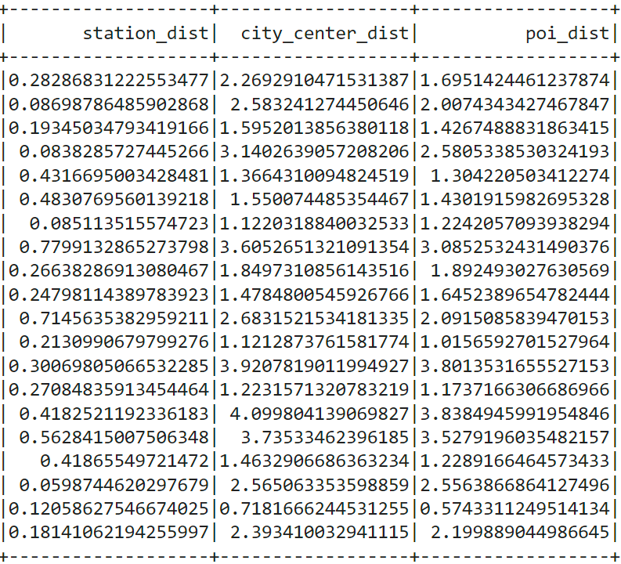
Feature Engineering 2
This operation was accomplished using Open Street Map to get the positions of each station/poi/city center across different cities and use them to compute the distances:
Final result: station, city center and POI distances from each accommodation

Slide 25
Feature Selection 1
After the data cleaning and feature engineering parts, the number of features was 77. Are all features useful to predict the price?
Spark dataframe temporarily converted to a Pandas dataframe in order to plot some graphs with Seaborn;
Heatmaps to study the (Pearson) correlation between the price and the other features;
Regplots to analyze if there was a linear correlation between the price and some (continuous) features;
Boxplots to understand the distribution of some (discrete) features with respect to the price.

Slide 26
Feature Selection 1
After the data cleaning and feature engineering parts, the number of features was 77. Are all features useful to predict the price?
Spark dataframe temporarily converted to a Pandas dataframe in order to plot some graphs with Seaborn;
Heatmaps to study the (Pearson) correlation between the price and the other features;
Regplots to analyze if there was a linear correlation between the price and some (continuous) features;
Boxplots to understand the distribution of some (discrete) features with respect to the price.
What came out was that only a few of them were helpful for predicting the price and they were linked to the size of the accommodation, the location and some amenities.

Slide 27
Feature Selection 2
But.. Selecting only the 10 most correlated features the model was heavily underfitting!
A higher complexity was needed due to the high number of observations;
Trial and error approach to find the best set of features;
I eventually had to select 31 (out of 77) features that gave me the best results.
selected_features = ['accommodates', 'bedrooms', 'n_bathrooms', 'is_children_friendly', 'availability_365', 'has_tv', 'is_bathroom_shared', 'room_type', 'has_bathtub', 'has_self_checkin', 'has_private_entrance', 'has_security_devices', 'calculated_host_listings_count', 'has_patio', 'is_smoking_allowed', 'poi_dist', 'has_free_parking', 'host_identity_verified', 'station_dist', 'review_scores_cleanliness', 'host_is_superhost', 'instant_bookable', 'host_response_time', 'has_elevator', 'review_scores_rating', 'review_scores_location', 'has_cooking_basics', 'number_of_reviews', 'city', 'has_paid_parking', 'minimum_nights']

Slide 28
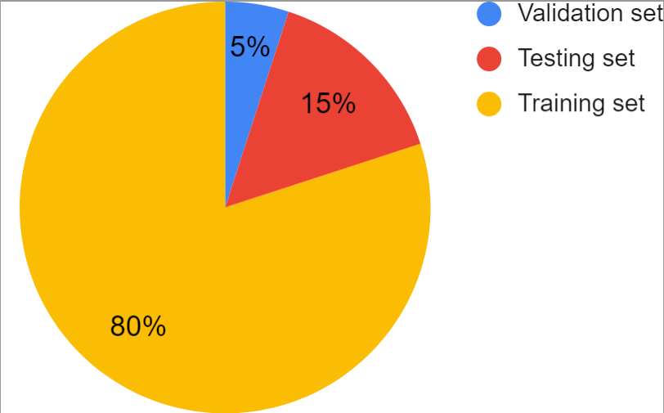
Model Training
Dataset divided into:
Training set (80%): For training the model;
Testing set (15%): For evaluating the model;
Validation set (5%): For hyperparameter tuning.
Several algorithms were used:
Linear Regression;
Random Forest Regression;
Gradient-Boosted Trees Regression;
Cross Validation in order to find the best set of hyperparameters.

Slide 29
Model Evaluation

Slide 30
Model Evaluation
Some considerations:
Only a few features are correlated with the price. Still, the correlation is not that high (p ≃ 0.46 for the size of the accommodation features, p ≃ 0.20 for some amenities, etc..);
The price is partially affected by those features but eventually it is a human decision. This is to say that we will never reach a better result (e.g. R2 > 0.80);
This task doesn’t require a perfect prediction but a simple advised price range, so these results are acceptable.

Slide 31
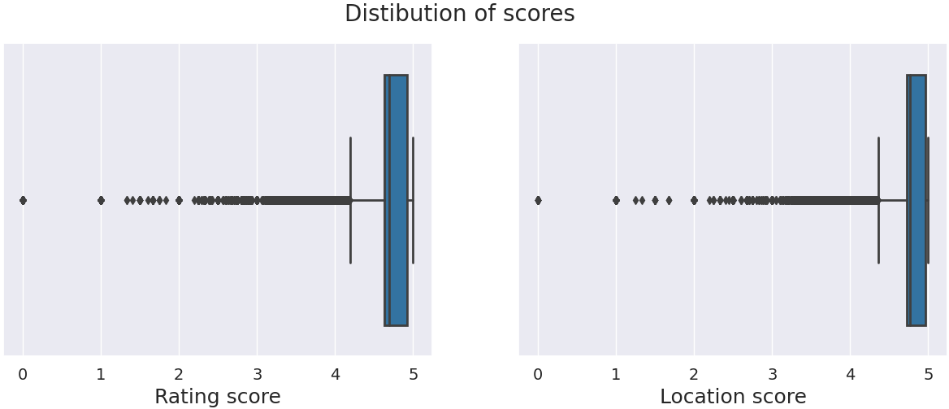
Score Prediction 1
Among the 31 features used by the price prediction model, 3 of them are scores (cleanliness, overall rating and location). When the host adds a new accommodation, he doesn’t have any score so we might try to predict them based on the characteristics of the Airbnb. This was done only for the overall rating and location scores since the cleanliness score depends on how the accommodation is managed so hardly predictable.
Scores are real values between 0 and 5 so I tried to fit a (regression) model following the same approach as before (feature selection, hyperparameter tuning, model training, model evaluation). Notice that scores are left-skewed so most of the values are between 4.5 and 5.

Slide 32
Score Prediction 2
Rating score model evaluation:
Location score model evaluation:

Slide 33
Score Prediction 3
Some consideration:
Results are bad because only few features were moderately correlated with the scores (still a low p < 0.20):
For the rating score some amenities and some information on the host;
For the location score the location itself and some amenities like the presence of a car park nearby.
They are not enough to predict the scores and if we also include the least correlated features (to increase the complexity of the model) the situation doesn’t change;
But, if we include the other scores (value, checkin, cleanliness, communication, etc..), results are way much better.

Slide 34
Score Prediction 4
For the rating score, we have these results: This might depend on the fact that guests are likely to give scores based on the whole experience rather than the actual characteristics of the Airbnb in fact most of the times there is no differences among the scores (e.g. a guest that gave 4.7 to the rating score, also gave a similar score to the other ones).

Slide 35
Score Prediction 4
For the rating score, we have these results: This might depend on the fact that guests are likely to give scores based on the whole experience rather than the actual characteristics of the Airbnb in fact most of the times there is no differences among the scores (e.g. a guest that gave 4.7 to the rating score, also gave a similar score to the other ones).
In the real scenario tests, we will use 2 approaches:
Static: I use the average scores to predict the price (I always use the same value).
Dynamic: I still try to use the predicted scores computed by these models just to see if there is a difference.

Slide 36



Real Scenario Tests 1
I built a web application using:
ReactJS for the frontend;
Django for the backend;
MySQL for the database.
Similarly to the Airbnb website, in my implementation the host can see his listings and add a new one by filling the required information;
After that, the host will be shown the advised price (2 different values predicted using the static and dynamic approach - just for test) and the scores;
Finally, he chooses a price ($/night), confirms everything and the listing is added to the website.

Slide 37
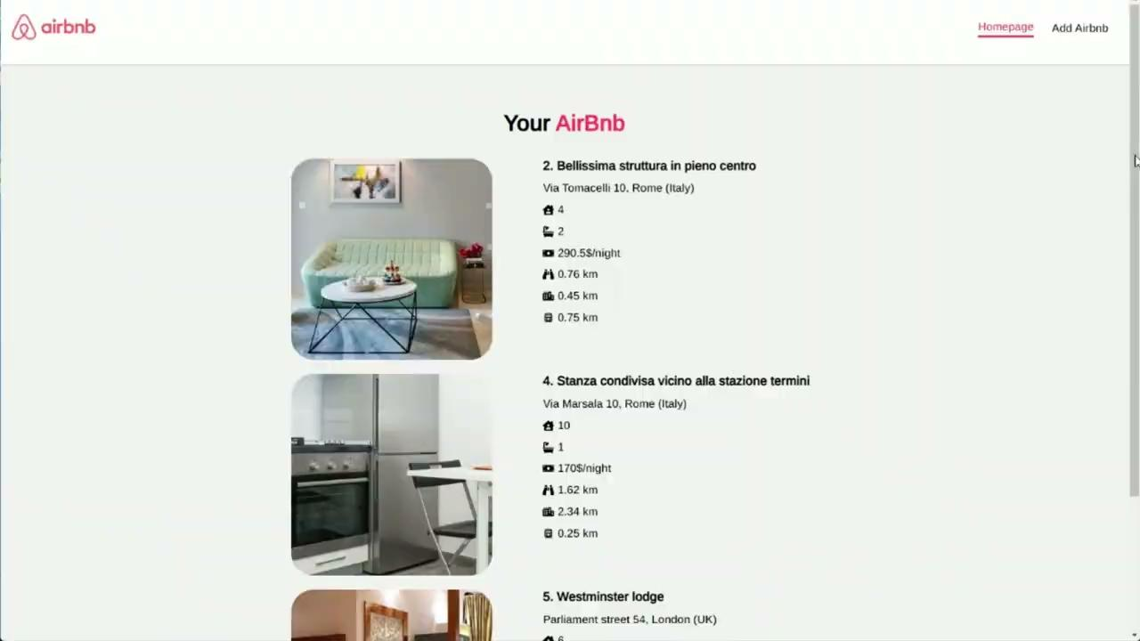
Real Scenario Tests 2
Note: You can find the videos in the “Demo” folder

Slide 38
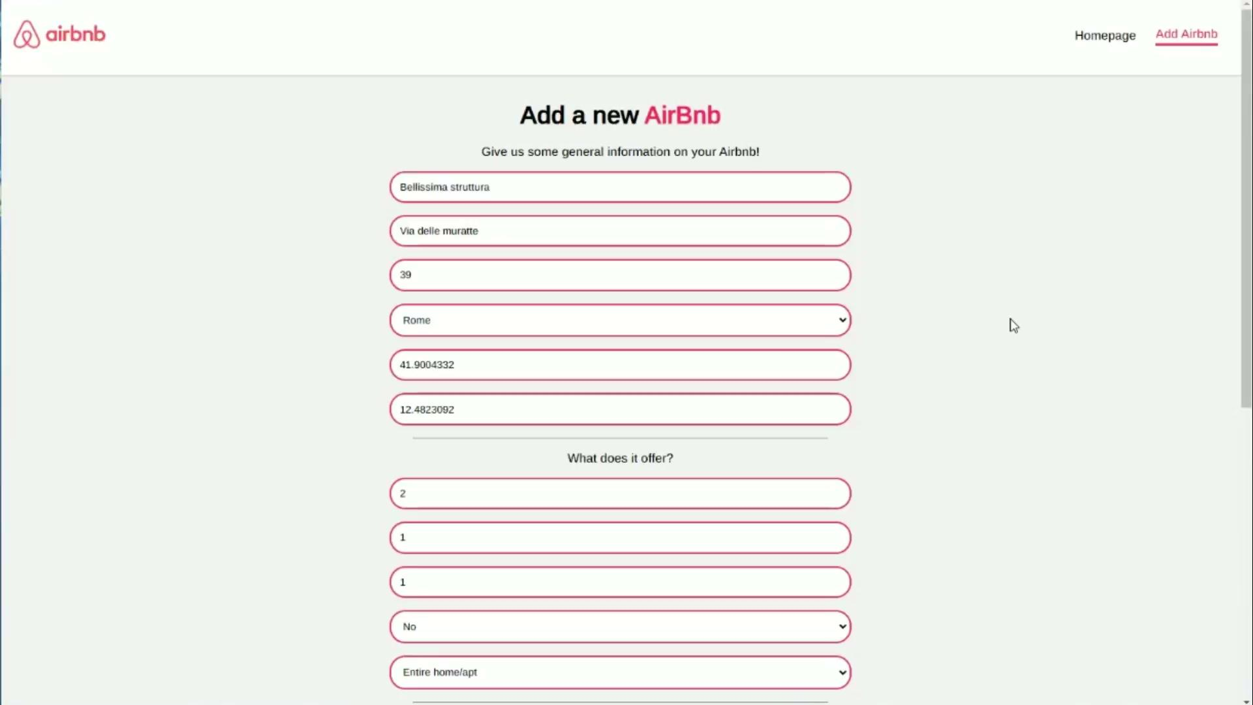
Real Scenario Tests 3
Note: You can find the videos in the “Demo” folder

Slide 39
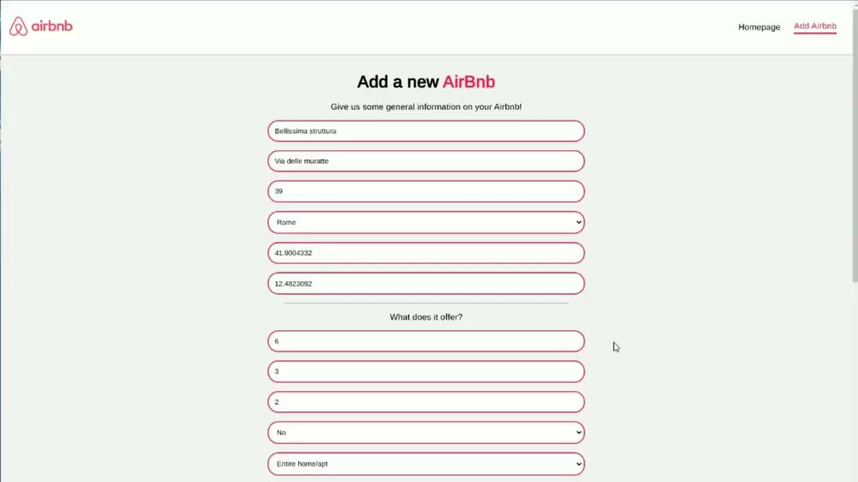
Real Scenario Tests 4
Note: You can find the videos in the “Demo” folder

Slide 40
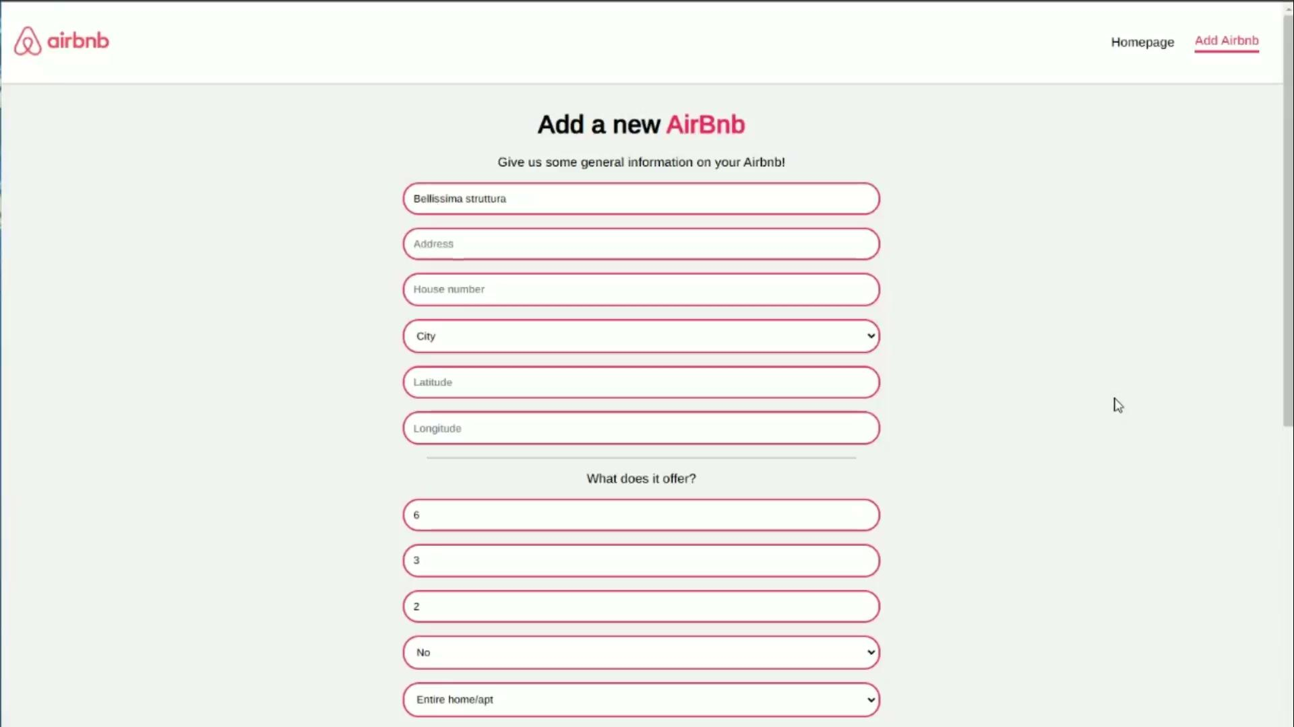
Real Scenario Tests 5
Note: You can find the videos in the “Demo” folder

Slide 41
Conclusions and Future Work
To sum up:
Raw dataset from Airbnb website required a heavy data preparation operation;
Data cleaning to get everything in a machine learning format;
Feature engineering to get useful information from the coordinates.
The best model was the GBT with a maxDepth of 7, maxIter of 13 and a stepSize of 0.2.
The score prediction model creation was unsuccessful due to the fact that the available features weren’t enough the describe the scores;
Web application to test the model in a real scenario.
Some future works:
Extend the dataset with other cities in the world to see if the results change;
Extend the dataset with time series (not available on the Airbnb website) to see how the price changes with the time of year.

Slide 42
Thanks for the attention

